Slide 1







Hi, JRC Murthy
Logout
Database Upload
Attendance Upload
Employee Attendance
E
E
Employee ID
Enter
Search Employee
Employee Add/Delete
E
Test Results
Attendance :
Report Generation
FAQ’s
Latest Updates
Submit
About Us | Terms of Use | GMP Standards | Privacy Policy
Copyright 2019 Shantha Biotechnics Private Limited – All Rights Reserved

Slide 2
Hi, JRC Murthy
Logout
E
Database Upload
Course Addititon
Employee Attendance
Search Employee
Employee Add/Delete
E
Course ID*
Enter
Test Results
Report Generation
E
Start Date *
Enter
FAQ’s
Latest Updates
End Date
nter
Submit
About Us | Terms of Use | GMP Standards | Privacy Policy
Copyright 2019 Shantha Biotechnics Private Limited – All Rights Reserved

Slide 3


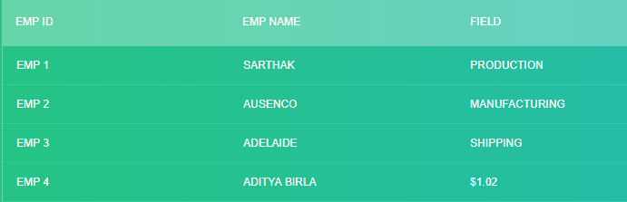

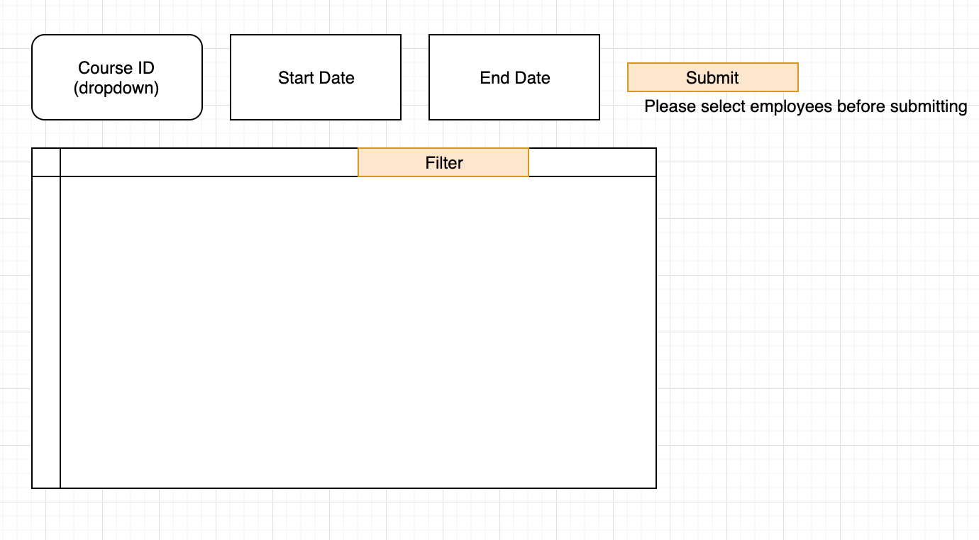
Hi, JRC Murthy
Logout
E`
Course Work Addition for Trainee : : employee selection for course
Database Upload
Start Date *
End Date
Employee Attendance
Search Employee
Filter :
Employee Add/Delete
Test Results
Report Generation
FAQ’s
Latest Updates
Submit
About Us | Terms of Use | GMP Standards | Privacy Policy
Copyright 2019 Shantha Biotechnics Private Limited – All Rights Reserved

Slide 4
Hi, JRC Murthy
Logout
Database Upload
Course Work Progress for Trainee
Employee Attendance
E
E
Employee ID
FAC00012
Enter
Search Employee
Employee Add/Delete
E
25%
Course ID
Dropdown
Ener
Test Results
E
Start Date
//populate automatically
Enter
Report Generation
FAQ’s
E
End Date
//populate automatically
Enter
Latest Updates
Submit
About Us | Terms of Use | GMP Standards | Privacy Policy
Copyright 2019 Shantha Biotechnics Private Limited – All Rights Reserved

Slide 5
Hi, JRC Murthy
Logout
Database Upload
Employee Attendance
Search Employee
Employee Add/Delete
Test Results
Report Generation
FAQ’s
Latest Updates
About Us | Terms of Use | GMP Standards | Privacy Policy
Copyright 2019 Shantha Biotechnics Private Limited – All Rights Reserved

Slide 6
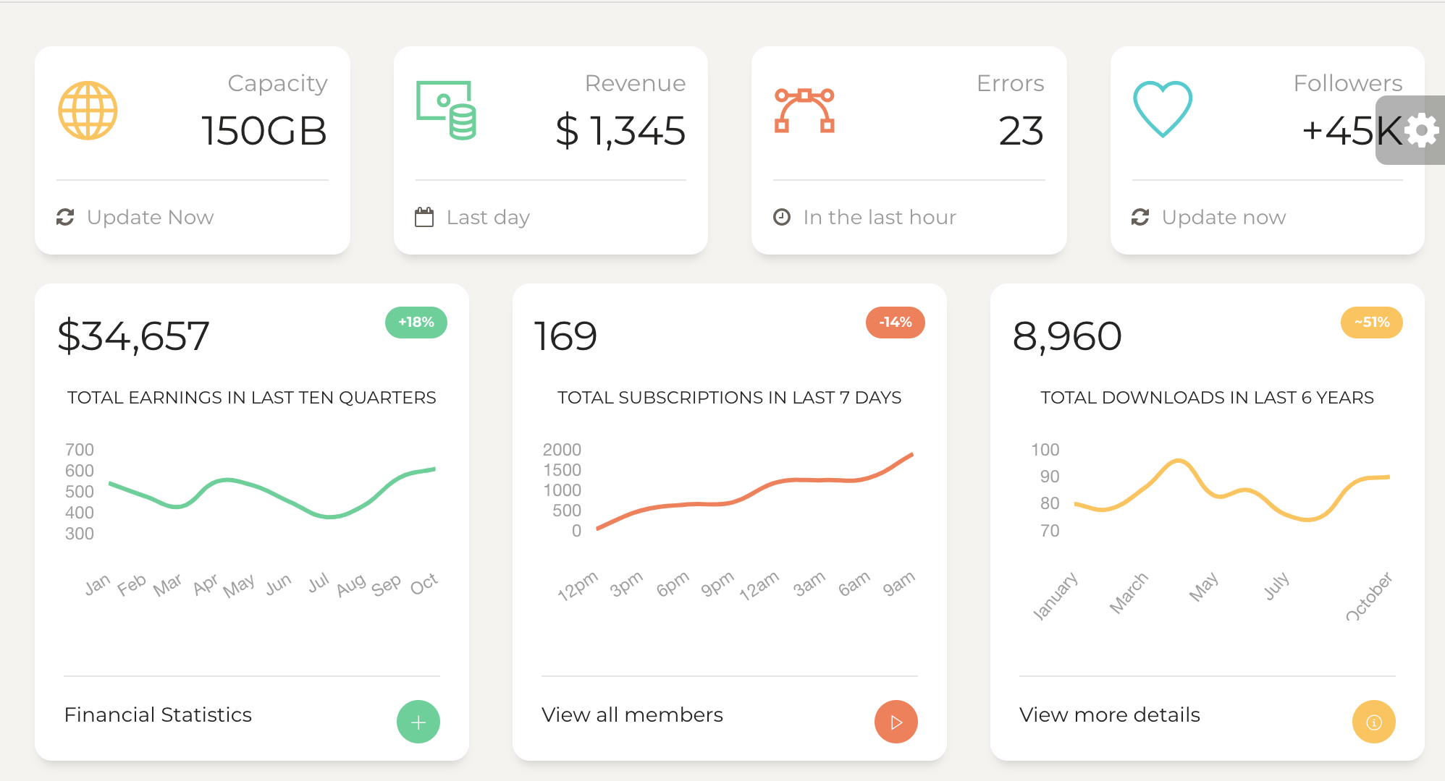
Hi, JRC Murthy
Logout
Generate New Batch
Database Upload
Employee Attendance
Search Employee
Employee Add/Delete
Test Results
Report Generation
FAQ’s
Latest Updates
About Us | Terms of Use | GMP Standards | Privacy Policy
Copyright 2019 Shantha Biotechnics Private Limited – All Rights Reserved

Slide 7
Hi, JRC Murthy
Logout
Database Upload
Employee Attendance
Employee Attendance
E
Employee ID
Enter
Search Employee
Employee Add/Delete
Test Results
Report Generation
FAQ’s
Latest Updates
About Us | Terms of Use | GMP Standards | Privacy Policy
Copyright 2019 Shantha Biotechnics Private Limited – All Rights Reserved

Slide 8
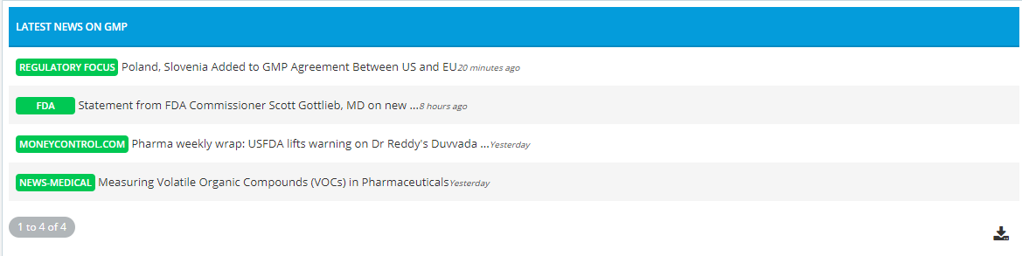
Hi, JRC Murthy
Logout
Latest Updates
Database Upload
Employee Attendance
Search Employee
Employee Add/Delete
Test Results
Report Generation
FAQ’s
Latest Updates
Latest Video Lectures
Latest News
Documentation
About Us | Terms of Use | GMP Standards | Privacy Policy
Copyright 2019 Shantha Biotechnics Private Limited – All Rights Reserved

Slide 9
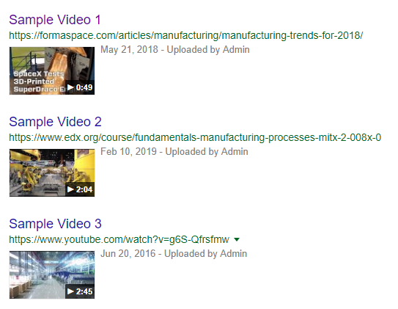
Hi, JRC Murthy
Logout
Latest Video Lectures : HARDCODE
Database Upload
Employee Attendance
Search Employee
Employee Add/Delete
Test Results
Report Generation
FAQ’s
Latest Updates
Latest News
Documentation
About Us | Terms of Use | GMP Standards | Privacy Policy
Copyright 2019 Shantha Biotechnics Private Limited – All Rights Reserved

Slide 10
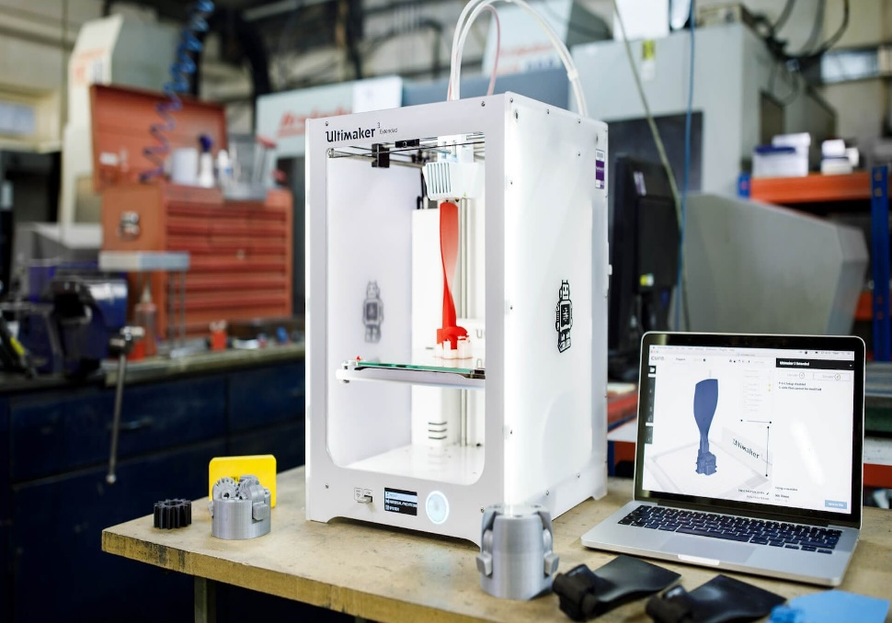
Hi, JRC Murthy
Logout
Latest Documentation
Database Upload
5 Technologies Now Changing Manufacturing
These technologies are having a disruptive impact on the factories of the future
As new technologies start to pervade all areas of our lives, we are beginning to see their application in the manufacturing industry. The German government coined the term ‘Industry 4.0’ which refers to this revolution of manufacturing through technology. While there is certainly some debate around the use of this term – the integration of production methods with the latest developments in computers certainly has the potential to make manufacturing autonomous, cheaper and more efficient. There are lots of ways this could be done, so what can we expect to see in the factory of the future?
1) Ultrafast 3D printing
Up until now, 3D printing has had limited applications in the manufacture of plastics. Making plastic layer by layer is a time consuming and expensive process compared to traditional techniques like injection moulding. However, Neil Hopkinson of the University of Sheffield has been working on a 3D printing technique which will make it economically viable to mass print plastic objects on a huge scale.
Employee Attendance
Search Employee
Employee Add/Delete
Slider
Test Results
Report Generation
FAQ’s
Latest Updates
TextBox
Submit
Latest News
Documentation
Latest Video Lectures
About Us | Terms of Use | GMP Standards | Privacy Policy
Copyright 2019 Shantha Biotechnics Private Limited – All Rights Reserved

Slide 11
Hi, JRC Murthy
Logout
Database upload
Employee Attendance
E
Search Employee
Employee Add/Delete
Test Results
Report Generation
FAQ’s
Latest Updates
About Us | Terms of Use | GMP Standards | Privacy Policy
Copyright 2019 Shantha Biotechnics Private Limited – All Rights Reserved

Slide 12
Hi, JRC Murthy
Logout
Database Upload
Employee Attendance
E
Search Employee
//Quick Insights
Employee Add/Delete
Test Results
Report Generation
FAQ’s
Latest Updates
About Us | Terms of Use | GMP Standards | Privacy Policy
Copyright 2019 Shantha Biotechnics Private Limited – All Rights Reserved

Slide 13
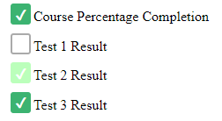
Hi, JRC Murthy
Logout
Database Upload
Alert Trainee
Employee Attendance
E
E
Employee ID
Enter
Search Employee
Employee Add/Delete
E
Course ID
Enter
Test Results
Report Generation
E
Test No.
Enter
FAQ’s
Latest Updates
Send SMS
Send SMS
About Us | Terms of Use | GMP Standards | Privacy Policy
Copyright 2019 Shantha Biotechnics Private Limited – All Rights Reserved

Slide 14
Shivay:
Addition of Course ::
Add multiple employees
Start Date, End Date :: Update Module 2
Module 1
Dashboard : 2nd & 3rd infoG
Cleaning
Sarthak : module 4
Dashboard : 4 fields + 1 infoG
Template ICONS.
Admin Actor
Admin ACTOR
Add Trainer Account
Delete Trainer Account
Add/ remove employee
Add employee Details
Database Upload

